Slide 1
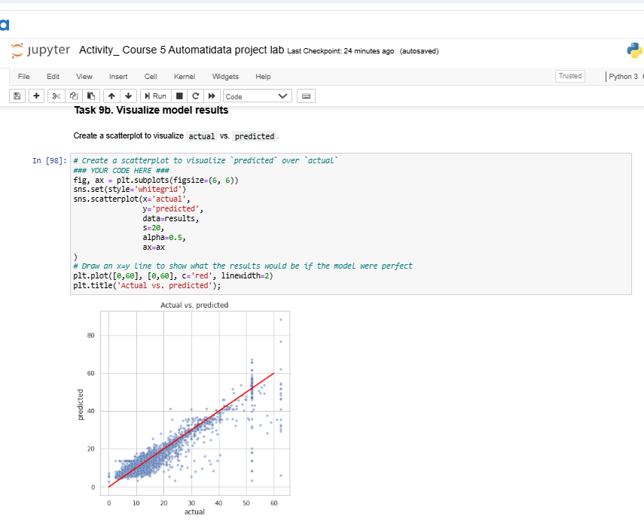
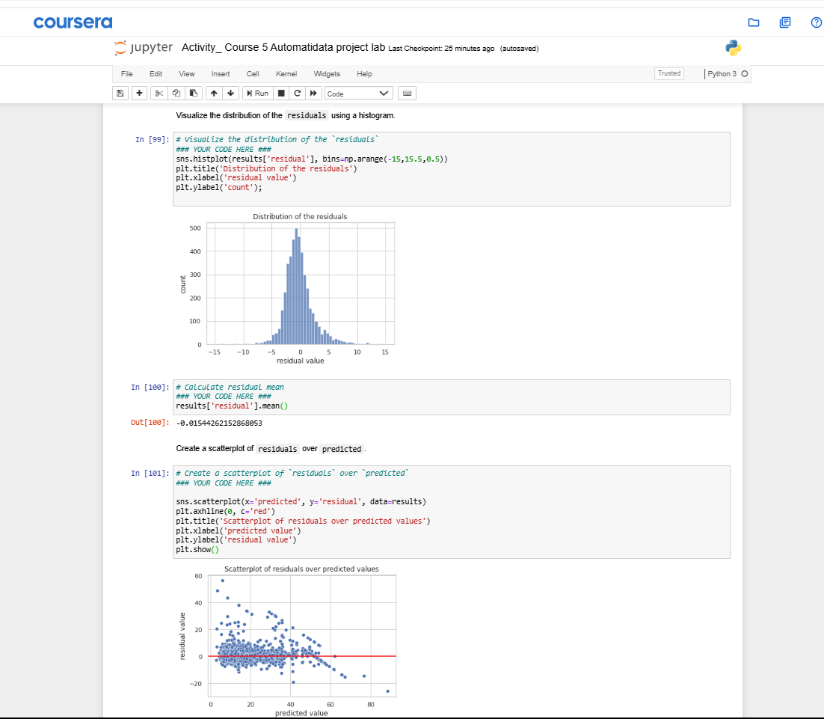
Title: NYC TLC Taxi Data: Fare Amount Prediction Model
Subtitle: Multiple Linear Regression Analysis Results
The NYC Taxi & Limousine Commission (TLC) requires a method to estimate taxi fares before a ride begins to potentially enhance transparency or operational planning, necessitating the development of a predictive model based on their available historical trip data.
A multiple linear regression (MLR) model was developed using the 2017 Yellow Taxi dataset; this involved extensive data cleaning (handling outliers in fare and duration), feature engineering (creating variables like mean_distance, mean_duration, rush_hour), feature scaling (standardization), and model training to predict Fare_amount based on readily available ride characteristics.
Image Alt-Text Here
The developed MLR model demonstrates strong predictive performance, explaining approximately 87% of the variance in fare amounts on unseen test data (Test R² ≈ 0.87) with a typical prediction error of about $3.79 (Test RMSE ≈ $3.79), indicating its significant potential utility for reliable pre-ride fare estimation.
Image Alt-Text Here
The model confirms that factors like mean_distance and mean_duration are highly significant predictors of Fare_amount, quantifying their impact. While the model is predictively strong, interpreting specific coefficient magnitudes requires noting that features were standardized before modeling; furthermore, residual analysis indicates overall good fit but suggests potential areas for minor refinement (e.g., addressing mild heteroscedasticity).

